Slide 1
Gemineye Emporium Pricing Optimization
Temitope Ajibulu

Slide 2
Objective
Develop Price Optimization Models: Create machine learning models to predict optimal prices for different jewelry pieces based on market data and costs.
Feature Selection (and Engineering): Identify (and engineer) relevant features that contribute to load capacity prediction accuracy.
Ensure explainable predictions: Ensure that the developed price prediction models are explainable and can give insights to the business analysts as regards. This will help the business administration trust the model predictions even more.

Slide 3
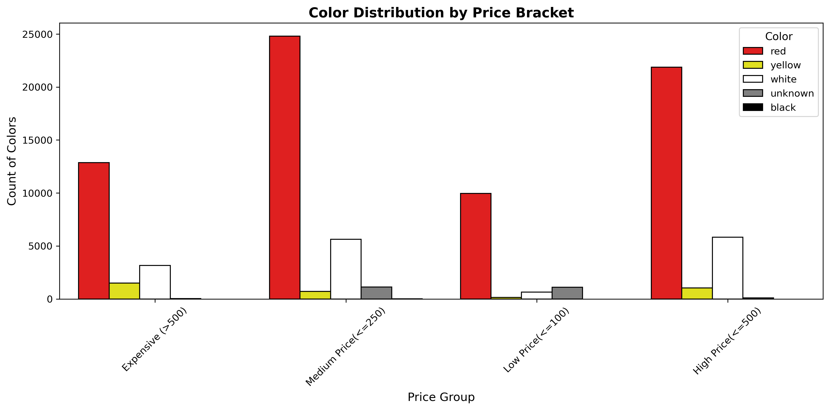
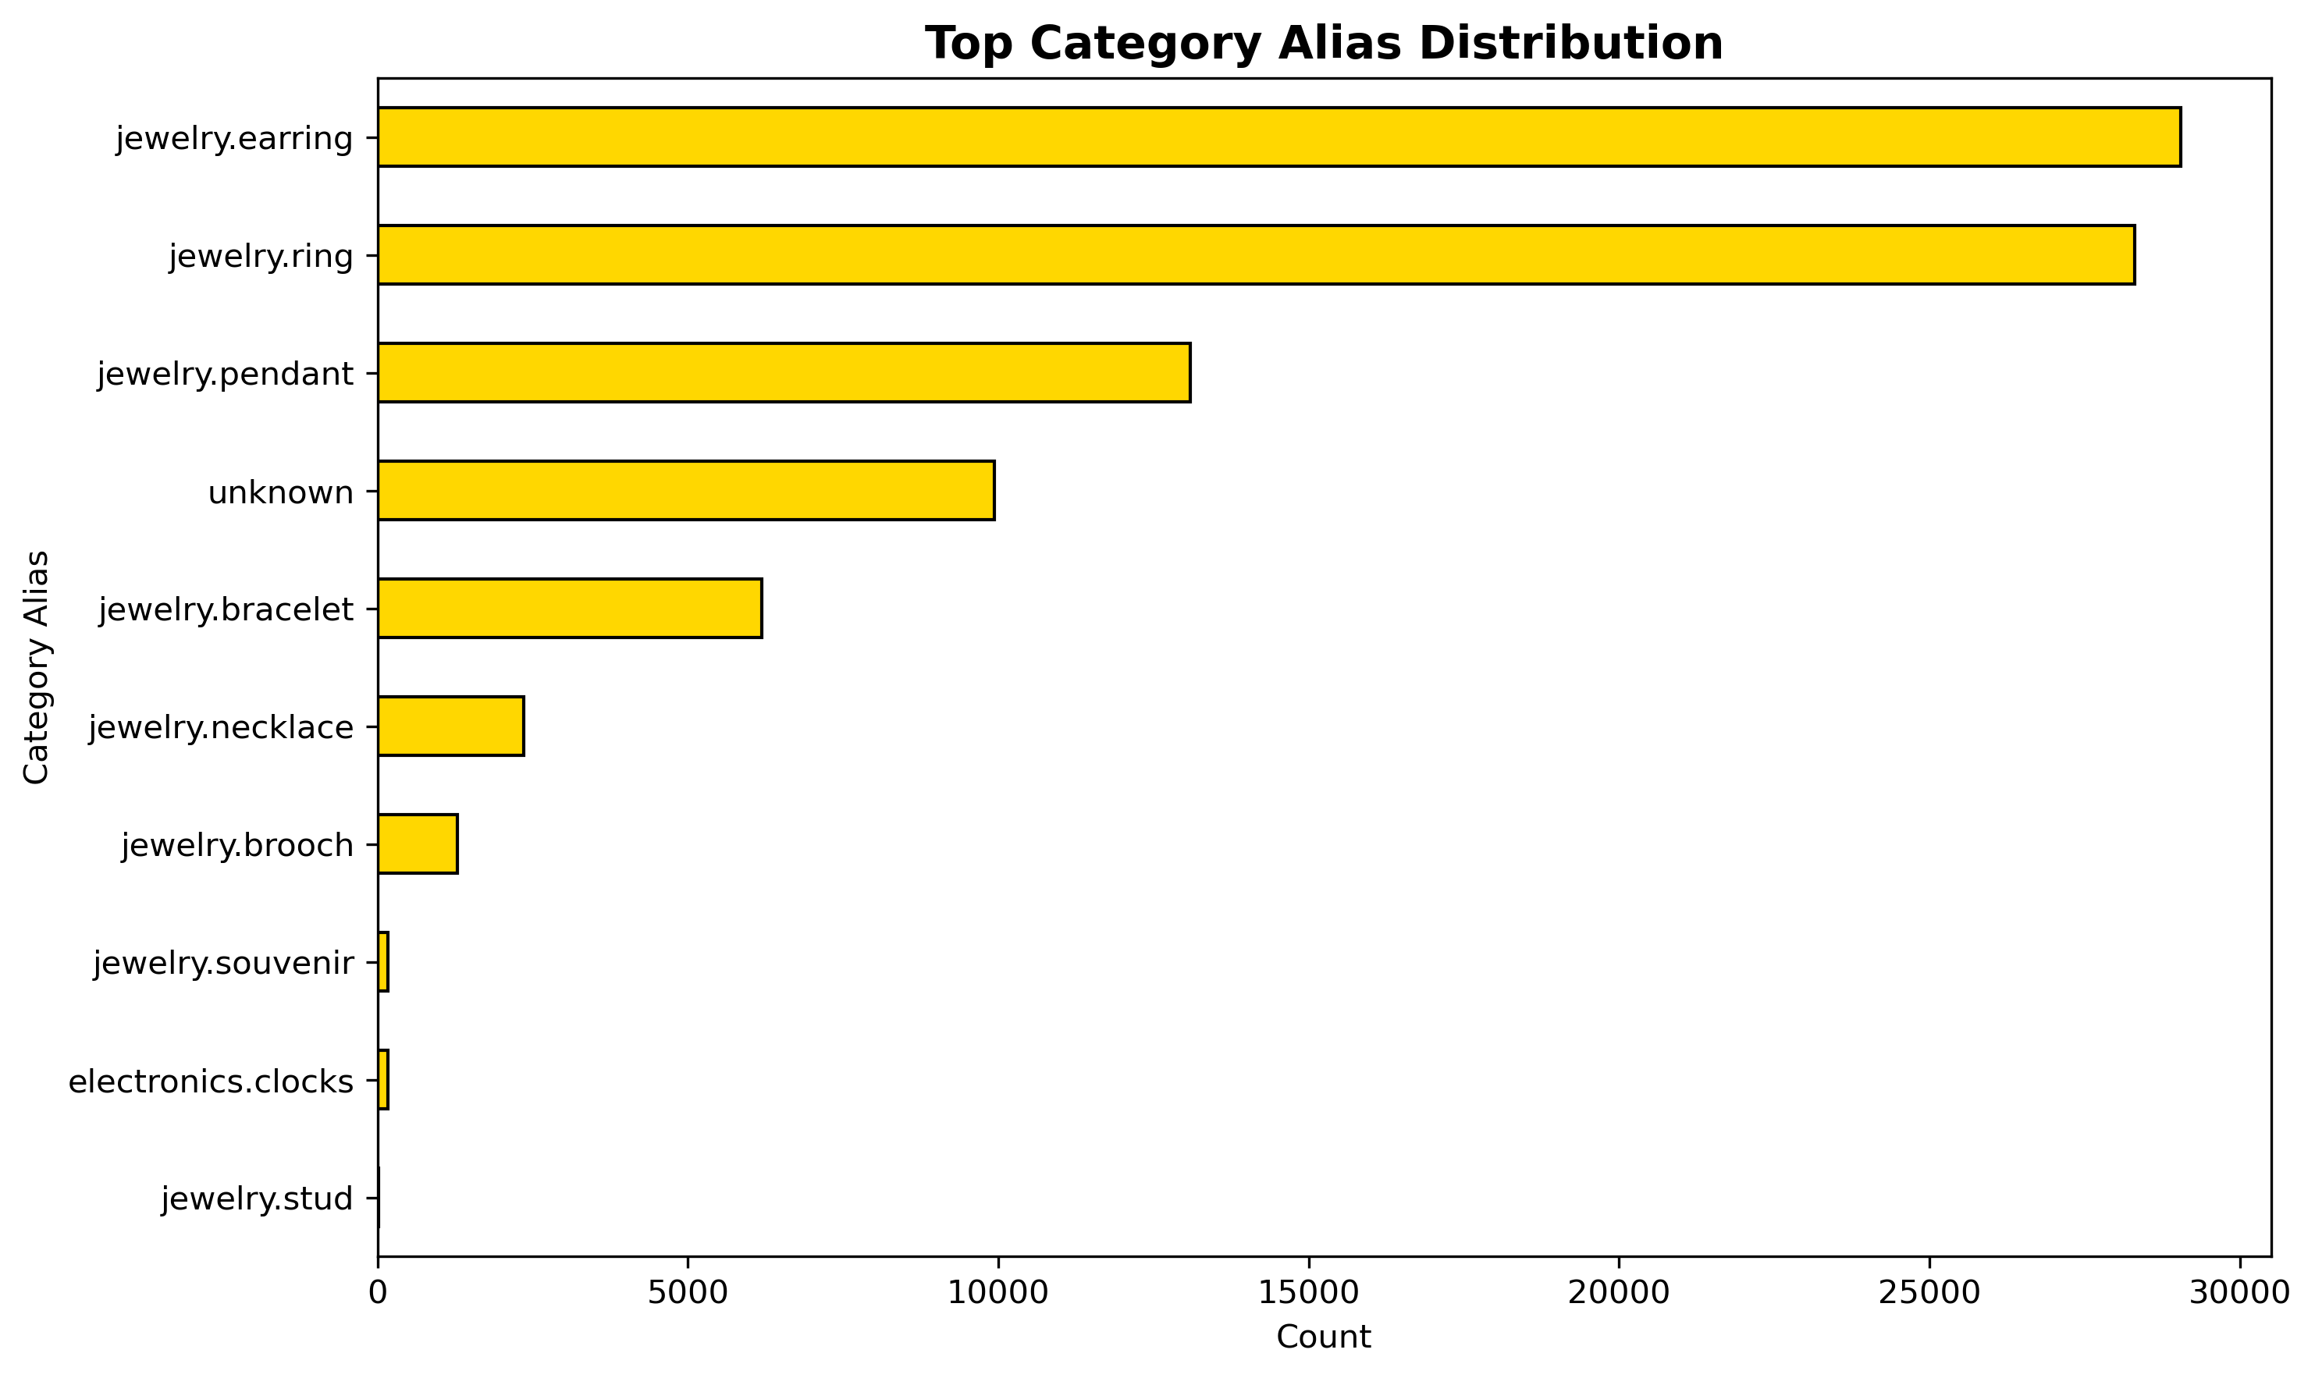
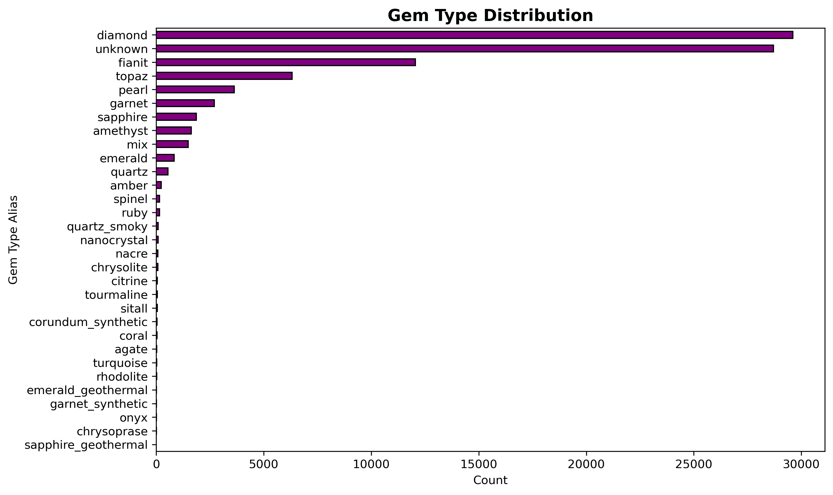
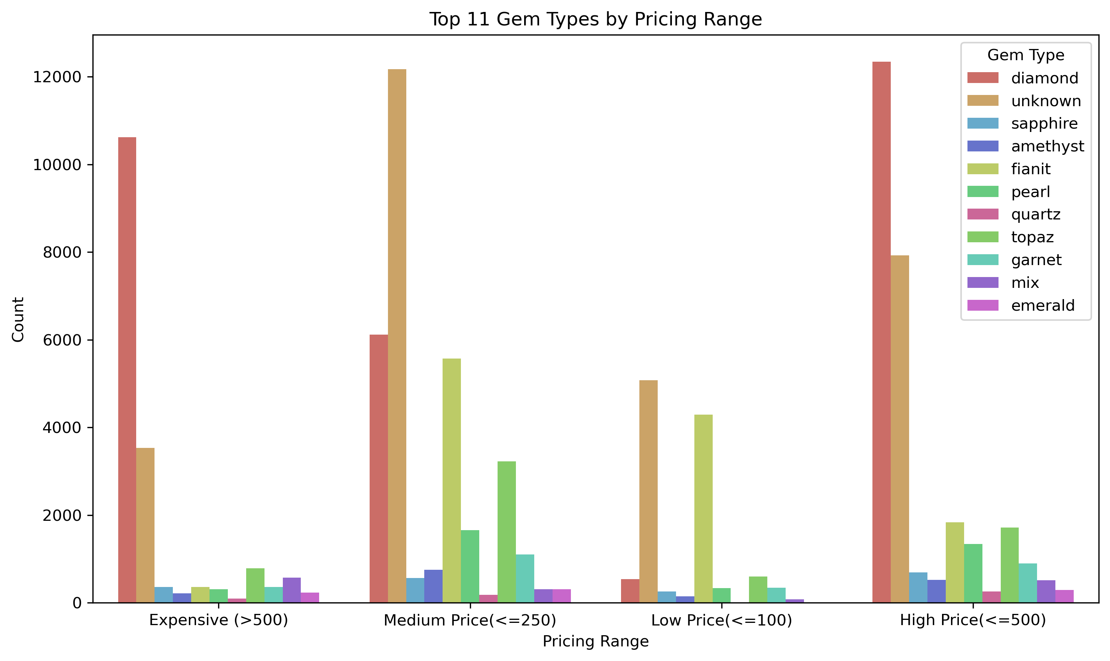
Distribution Charts

Slide 4
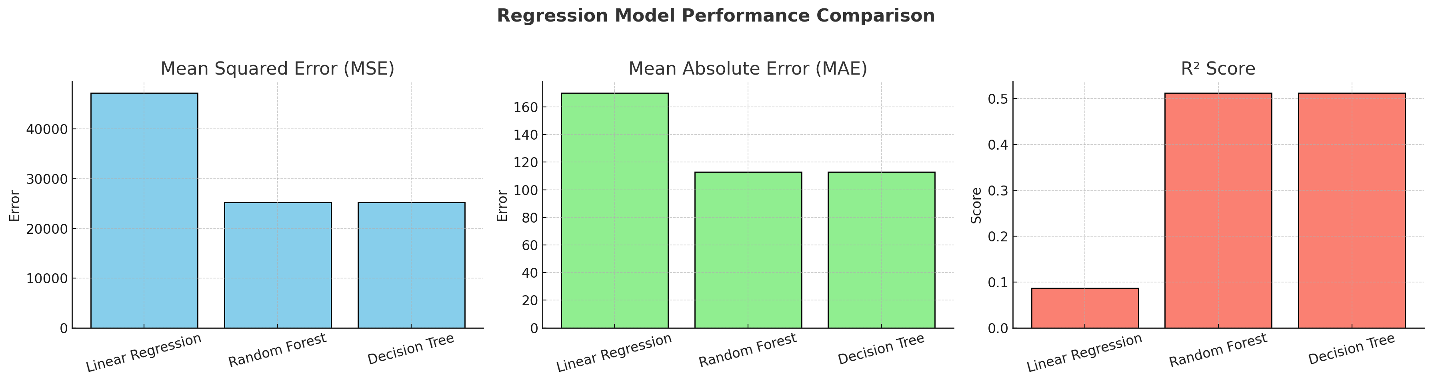
Regression Models Tested
Evaluation Score | Mean Squared Error (MSE) | Mean Absolute Error (MAE) | R-Squared
Linear Regression | 47255.76 | 170.09 | 0.0865
Random Forest | 25252.59 | 112.81 | 0.5118
Decision Tree | 25260.25 | 112.75 | 0.5117

Slide 5
Conclusion
Random Forest and Decision Tree models significantly outperform Linear Regression.
This suggests that the relationship between features and the target variable is non-linear or complex, which tree-based models are better suited to capture.
Random Forest slightly edges out Decision Tree in R² and MSE.
Random Forest is more robust due to its ensemble nature and typically generalizes better.
Gemineye should work on cleaning up how they collect data. Reduce missing values.
Focus on Product_gender , Color , Brand_ID, Gem Type, Category alias and Metal to determine pricing strategy

Slide 6
THANK YOU!!!!

